Slide 1
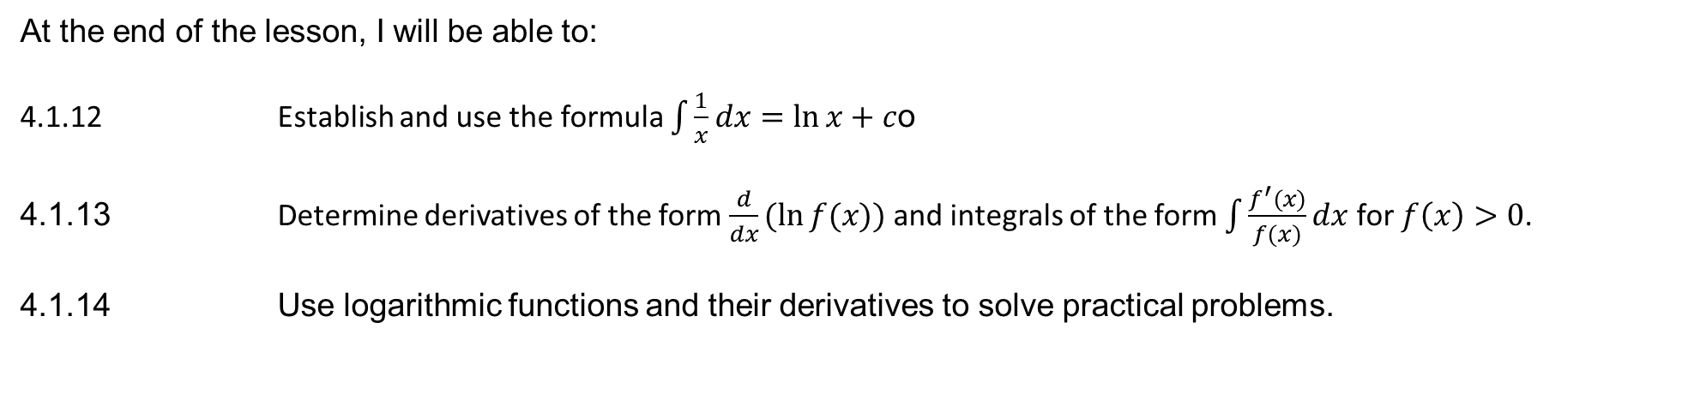
Learning Objective
I will be able to integrate reciprocal functions to solve practical problems
Success Criteria
At the end of the lesson, I will be able to:
4.1.12 Establish and use the formula $\int{\frac{1}{x}dx}=\ln{x}+c$o
4.1.13 Determine derivatives of the form $\frac{d}{dx}(\ln{f(x))}$ and integrals of the form $\int{\frac{f^{′}(x)}{f(x)}}dx$ for $f\left(x\right)>0$.
4.1.14 Use logarithmic functions and their derivatives to solve practical problems.

Slide 2


Integrating Logarithmic Functions
If:
y = ln(x) then $\frac{dy}{dx}$ = $\frac{1}{x}$
Integrating $\frac{dy}{dx}$ = $\frac{1}{x}$ would give us y = ln(x) + c
Similarly if:
y = ln(f(x)) then $\frac{dy}{dx}$ = $\frac{f^{′}(x)}{f(x)}$
Integrating $\frac{dy}{dx}$ = $\frac{f^{′}(x)}{f(x)}$ would give us y = ln(f(x)) + c
Note that x > 0 and f(x) > 0, since we cannot take negative logarithms.
Sometimes your solution on the Classpad will appear as ln|x| + c instead of ln(x) + c, to ensure that x remains positive.
Therefore,

Slide 3



Guided Practice
Determine $\int{\frac{3}{5x}dx}$
$\int{\frac{3}{5x}dx}$ = $\int{\frac{3}{5}×\frac{1}{x}dx}$
= $\frac{3}{5}\int{\frac{1}{x}dx}$
= $\frac{3}{5}\ln\left(x\right)$ + c
Determine $\int{\frac{2x −3}{x^{2}−3x+5}dx}$
Check that the numerator is fully factorised first.
Notice that the derivative of x² – 3x + 5 is 2x – 3.
Therefore:
$\int{\frac{2x −3}{x^{2}−3x+5}dx}$ = ln(x² -3x + 5) + c
Determine $\int{\frac{6x+15}{x^{2}+5x}dx}$
$\int{\frac{6x+15}{x^{2}+5x}dx}=\int{\frac{3(2x+5)}{x^{2}+5x}dx}=3\int{\frac{2x+5}{x^{2}+5x}}dx$
Notice that the derivative of $x^{2}+5x$ is $2x+5$
Therefore:
$\int{\frac{6x+15}{x^{2}+5x}dx}= 3\ln{(x^{2}+5x)}+c$

Slide 4

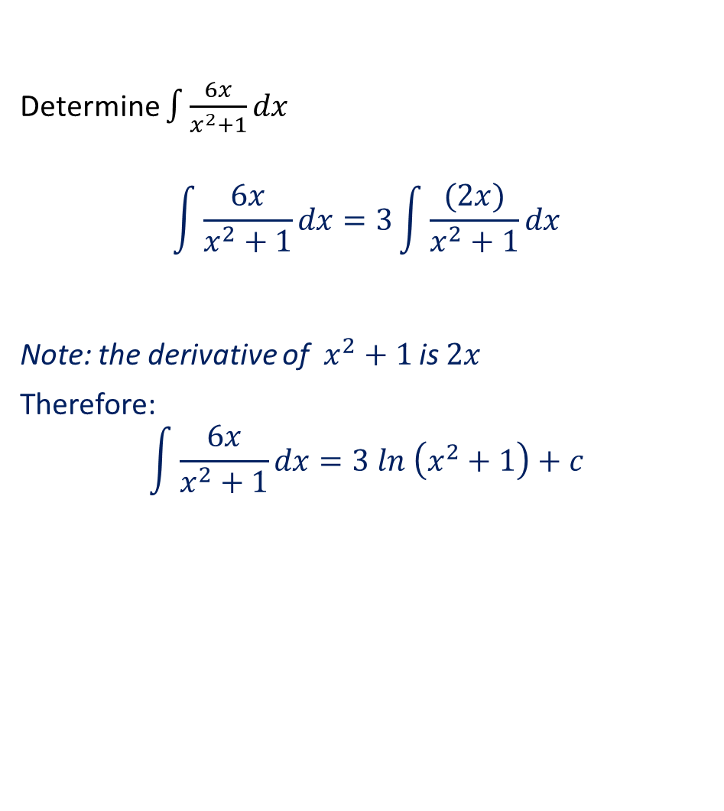
Guided Practice
Determine $\int{\frac{6x}{x^{2}+1}dx}$
$$\int{\frac{6x}{x^{2}+1}dx}=3\int{\frac{(2x)}{x^{2}+1}dx}$$
Note: the derivative of $x^{2}+1$ is $2x$
Therefore:
$$\int{\frac{6x}{x^{2}+1}dx}=3 ln \left(x^{2}+1\right)+c$$
Determine $\int{\frac{e^{x}}{e^{x}+1}dx}$
Note: the derivative of $e^{x}+1$ is $e^{x}$.
Therefore:
$\int{\frac{e^{x}}{e^{x}+1}dx}=ln \left(e^{x}+1\right)+c$

Slide 5


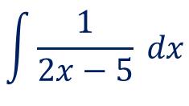
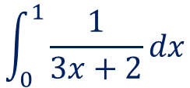

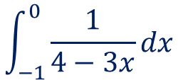
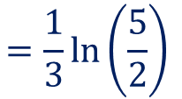


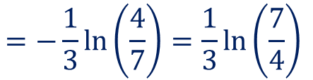
Guided Practice
Evaluate the following integrals:
a) $\int{\frac{1}{2x−5}}dx$ b)$\int_{0}^{1}{\frac{1}{3x+2}}dx$ c)$\int_{−1}^{0}{\frac{1}{4−3x}}dx$
$$\int{\frac{1}{2x−5} dx}$$
$$\int_{−1}^{0}{\frac{1}{4−3x}}dx$$
$$\int_{0}^{1}{\frac{1}{3x+2}}dx$$
$$=\frac{1}{2}\ln{|2x−5|}+c$$
$$={\frac{1}{3}\left[\ln{| 3x+2|}\right]}_{0}^{1}$$
$$={−\frac{1}{3}\left[\ln{| 4−3x|}\right]}_{−1}^{0}$$
$$=\frac{1}{3}\left[\ln\left(5\right)−\ln\left(2\right)\right]$$
$$=−\frac{1}{3}\left[\ln\left(4\right)−\ln\left(7\right)\right]$$
$$=\frac{1}{3}\ln\left(\frac{5}{2}\right)$$
$$=−\frac{1}{3}\ln\left(\frac{4}{7}\right)=\frac{1}{3}\ln\left(\frac{7}{4}\right)$$

Slide 6

Guided Practice
Find the area between the x-axis and y = $\frac{2x+1}{x}$ from x = 1 to x = 3.
$$\int_{1}^{3}{\frac{2x+1}{x}dx= \int_{1}^{3}{\frac{2x}{x}+\frac{1}{x}dx}}$$
$= {[2x+\ln\left(x\right)]}_{1}^{3}$
$=6+\ln\left(3\right)−(2+\ln\left(1\right))$
$$=4+\ln\left(3\right)$$
Hence the area under the curve is 4 + ln(3) units²

Slide 7


Guided Practice
REMEMBER, when a question says ‘hence evaluate’ it implies you must show the use of your previous answer to respond to this part of the question.
Differentiate $\ln{(3x^{2}+7)}$ and hence evaluate $\int_{0}^{2}{\frac{x}{3x^{2}+7}dx}$
$$f\left(x\right)=\ln{(3x^{2}+7)}$$
$$f^{′}\left(x\right)=\frac{6x}{{3x}^{2}+7}$$
$$\int_{0}^{2}{\frac{x}{3x^{2}+7}dx=} \frac{1}{6}\int_{0}^{2}{\frac{6x}{{3x}^{2}+7}dx}$$
$$\frac{1}{6}\left[ln({3x}^{2}+7)\right]\begin{matrix}2 \\ 0\end{matrix}=\frac{1}{6}\left[ln\left(19\right)−ln(7)\right]$$
$$= \frac{1}{6}ln\left(\frac{19}{7}\right)$$

Slide 8


Guided Practice
If $f\left(x\right)=x\ln\left(2x\right)$, determine $f′(x)$ and hence find $\int{\ln{2x}dx}$
$f^{′}\left(x\right)=1+\ln{2x}$ (by the Product Rule)
By FTC:
$$\int{\frac{d}{dx}(x\ln{2x) dx}=\int{1}dx+\int{\ln{2x}}dx}$$
$$\int{\frac{d}{dx}(x\ln{2x) dx}}−\int{1}dx=\int{\ln{2x}}dx$$
$$\int{\ln{2x}}dx=x\ln{2x−x+c}$$

Slide 9
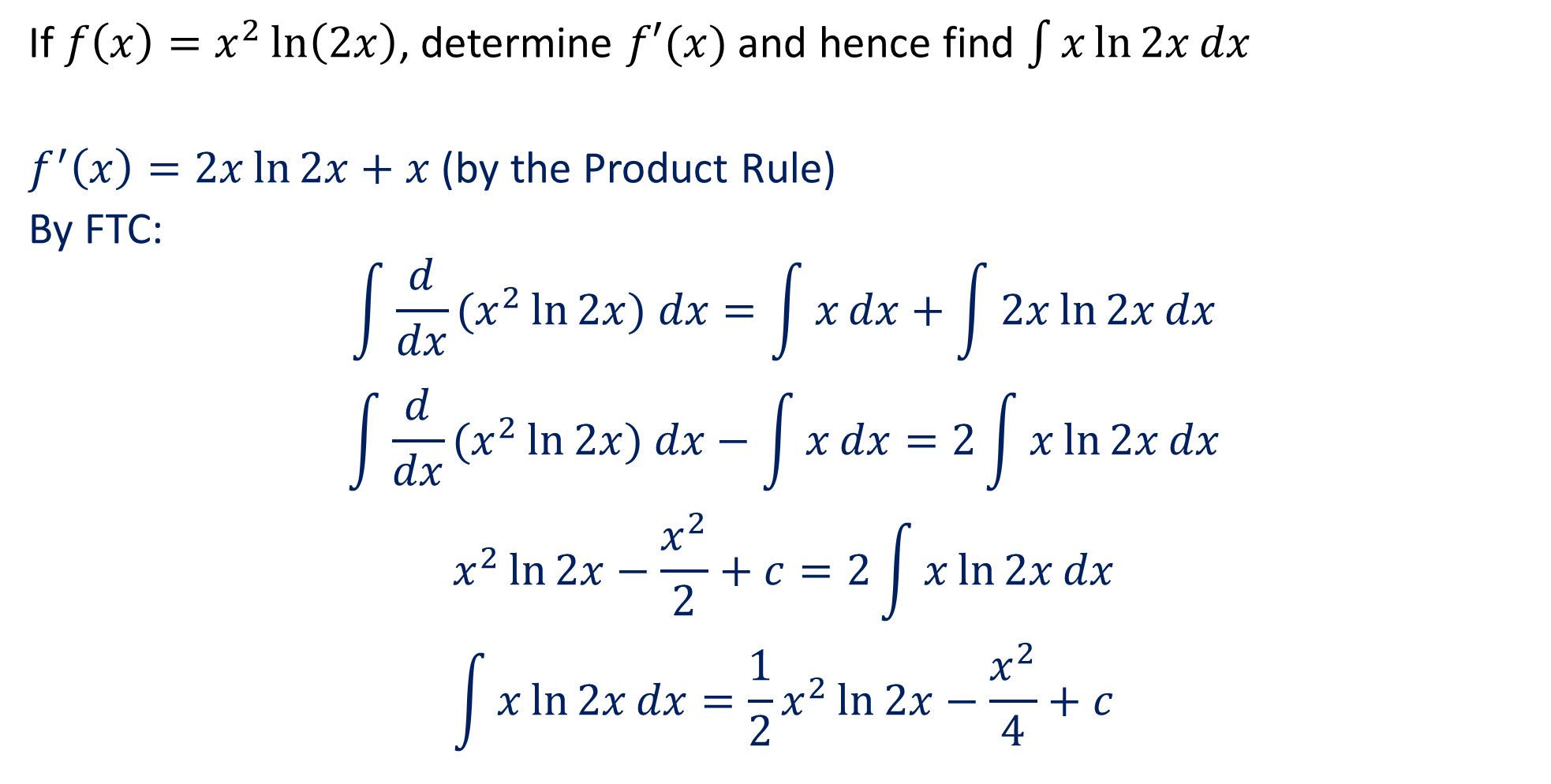
Guided Practice
If $f\left(x\right)=x^{2}\ln\left(2x\right)$, determine $f′(x)$ and hence find $\int{x\ln{2x}dx}$
$f^{′}\left(x\right)=2x\ln{2x}+x$(by the Product Rule)
By FTC:
$$\int{\frac{d}{dx}(x^{2}\ln{2x) dx}=\int{x}dx+\int{2x\ln{2x}}dx}$$
$$\int{\frac{d}{dx}(x^{2}\ln{2x) dx}}−\int{x}dx=2\int{x\ln{2x}}dx$$
$$x^{2}\ln{2x}−\frac{x^{2}}{2}+c=2\int{x\ln{2x}}dx$$
$$\int{x\ln{2x}}dx=\frac{1}{2}x^{2}\ln{2x}−\frac{x^{2}}{4}+c$$

Slide 10
Independent Practice
Complete Ex 6C, 6E, 6H

